Slide 1
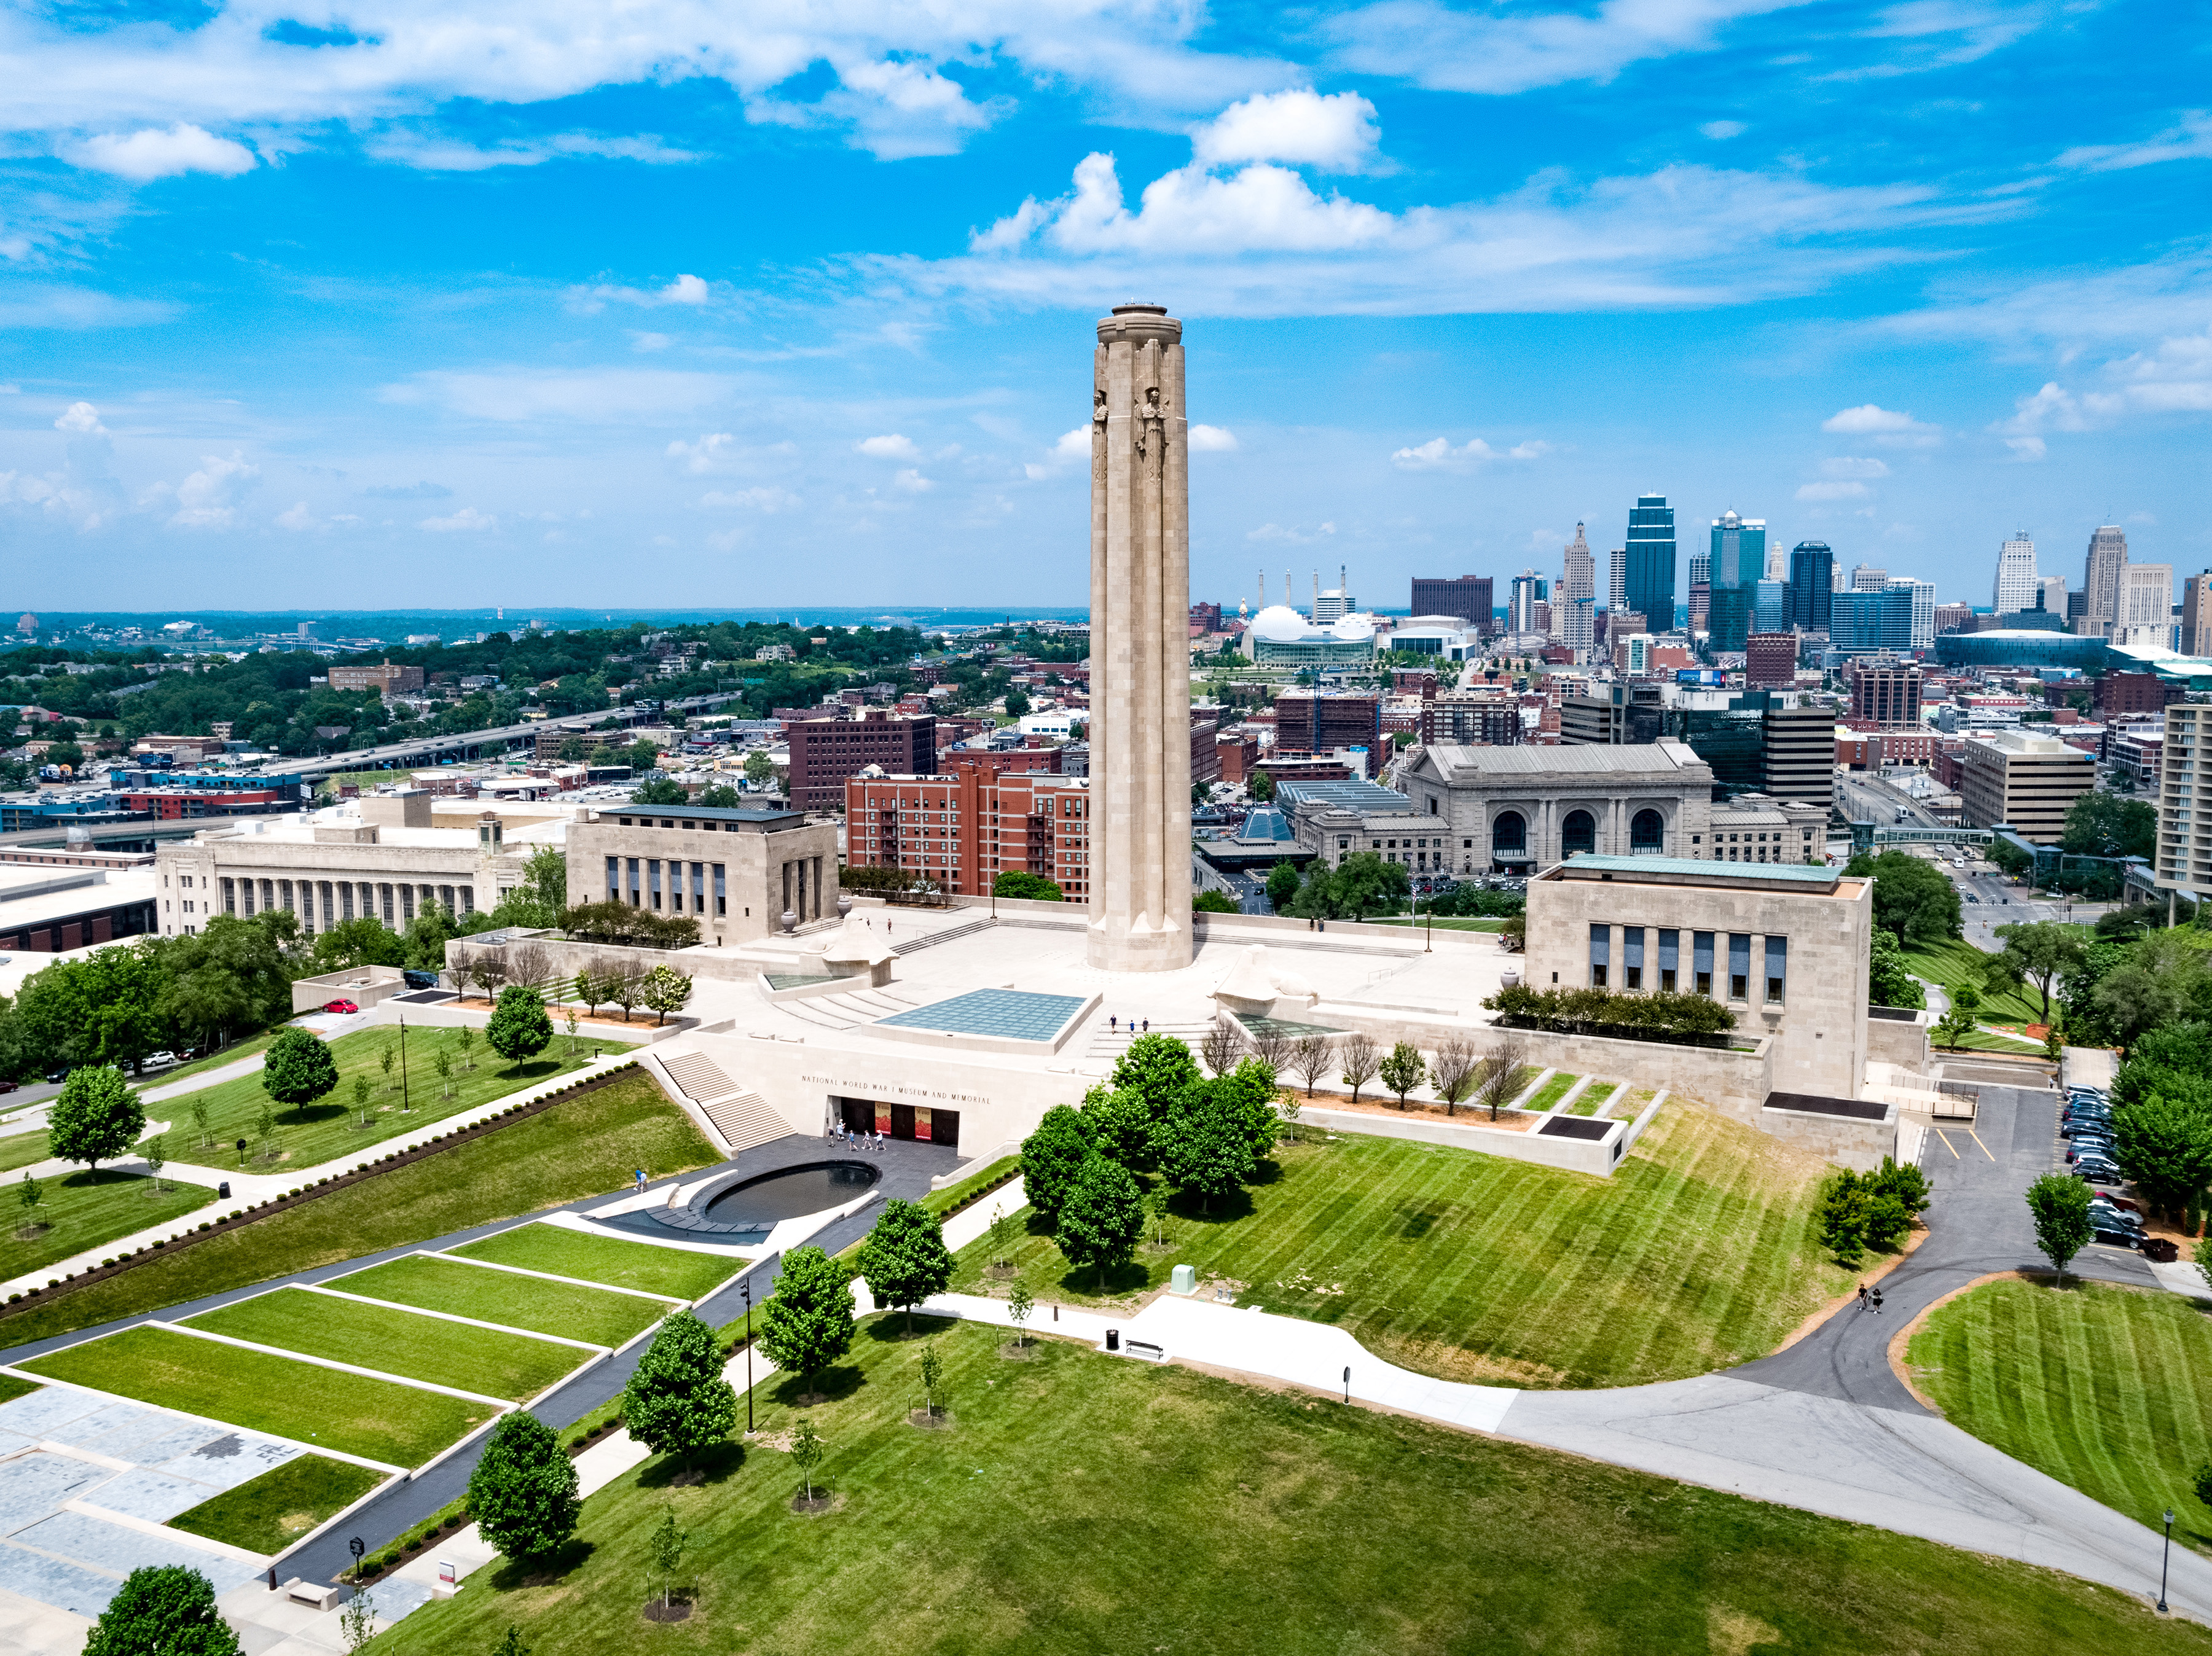

Slide 2
WWI Memorials

Slide 3
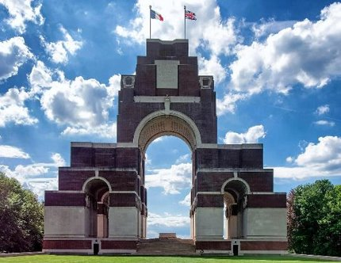
THE THIEPVAL MEMORIAL:​ MEMORIAL TO THE MISSING OF THE SOMME​

Slide 4
IDENTIFY
Describe the Memorial to the Missing at the Somme battlefield. Why do you think it is so large?​
What does the fact that a memorial to the missing (in action) was built tell us about this battle, and WWI in general?​
Why would a nation want to build a memorial to the missing in action?​

Slide 5
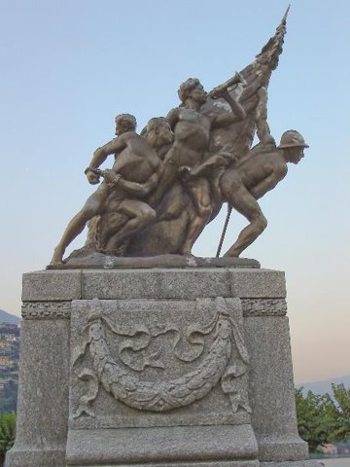
WORLD WAR I MEMORIAL IN CERNOBBIO, ITALY​

Slide 6
synthesize
Describe the memorial in detail. How are the soldiers being portrayed in this sculpture?​
Assume you’re an officer speaking at a dedication ceremony. Write a short speech answering the following questions:​
What does this sculpture tell us about the Italian view of the war?​
How did the soldiers conduct themselves in this war? ​
How does this monument honor the soldiers of Italy?​

Slide 7
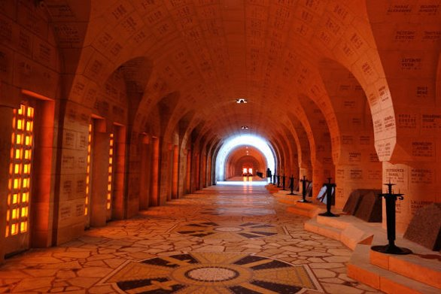
DOUAUMONT OSSUARY AT VERDUN BATTLEFIELD, FRANCE

Slide 8
EMPATHIZE
This is a memorial to the French dead at Verdun, a battle where approximately a half million French soldiers were killed or wounded.​
Imagine that this memorial could talk. What would it tell you about the French soldiers who fought at Verdun? How does the memorial try to bring peace to the living? Why are there no patriotic symbols, weapons, or images of soldiers in this war memorial? What might that tell us about the message this memorial is trying to convey?​

Slide 9
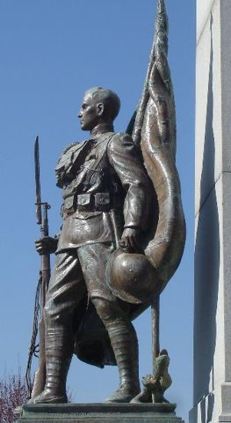
WORLD WAR MEMORIAL, ENGLEWOOD, NJ

Slide 10
EXPRESS
This is an American memorial, located in Englewood, New Jersey. The Americans were on the winning side of this war.​
What emotions are expressed in this sculpture? How does this sculpture reflect an attitude of victory? Of optimism? Why might the Americans have this attitude, where the French or British might not?

Slide 11
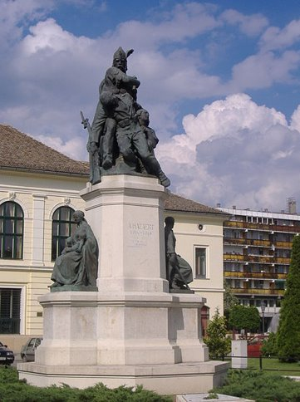
FIRST WORLD WAR MEMORIAL, MAKÓ, HUNGARY

Slide 12
COMPARE
This is a war memorial in Hungary, which was on the losing side of the war.​
What is the “mood” of this memorial? How does it convey the loss and sacrifice that these soldiers suffered?​
Does it convey a sense of honor among soldiers? If so, how?​
Finally, there is a woman with her children in this sculpture. Why would they be present in a memorial?

Slide 13
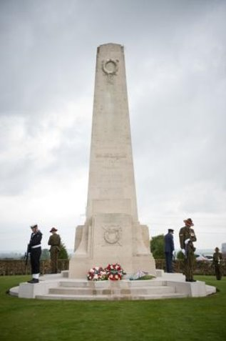
NEW ZEALAND MEMORIAL IN SOMME, FRANCE

Slide 14
IDENTIFY
The memorial is made by and for New Zealand, a nation which fought with the British, and was victorious in the World War.​
Describe the features of this memorial. What does its size tell us about the intent of its builders?​
What might the lack of soldiers or weapons at this memorial tell us about how the New Zealanders view this war?

Slide 15
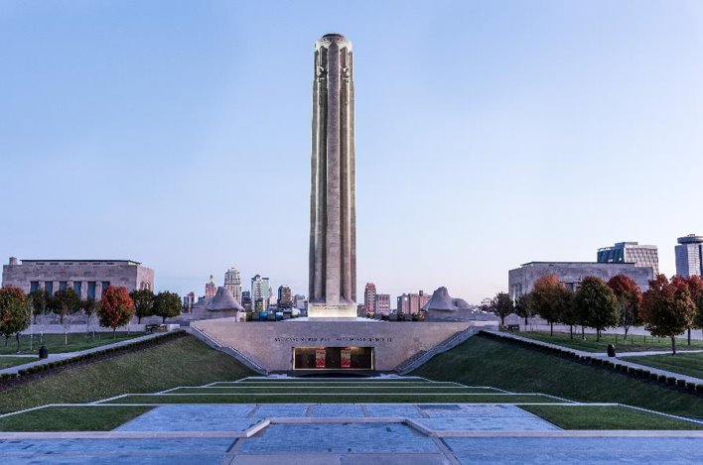
NATIONAL WWI MUSEUM AND MEMORIAL, KANSAS CITY, MO

Slide 16
SYNTHESIZE
The National WWI Museum and Memorial in Kansas City, Missouri was dedicated in 1921 under the name "Liberty Memorial" as a monument to America’s involvement in World War I.​
Assume you are a public official making a brief speech at the dedication ceremony. Draft a brief speech in which you address the following questions:​
Why is this monument called the Liberty Memorial Tower?​
Why build a monument at such a large scale?​
Why should Americans believe this war was worth fighting? (Regardless of personal beliefs, remember who might be in the audience!)​
Why should Americans memorialize those who gave their lives?

Slide 17
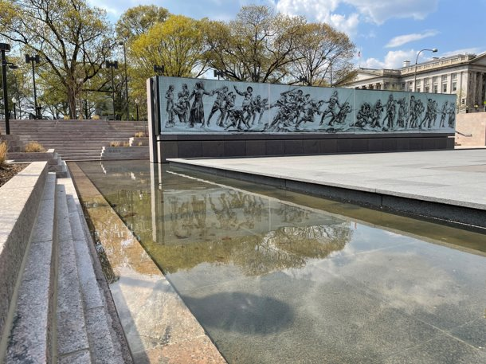
NATIONAL WORLD WAR I MEMORIAL IN WASHINGTON, D.C.

Slide 18
COMPARE
This is the National World War I Memorial in Washington, D.C. ​
How is it different from the National WWI Museum and Memorial, the United States’ other national memorial?​
Why might a nation have a memorial built in 1926, but then open a new one in 2021?

Slide 19
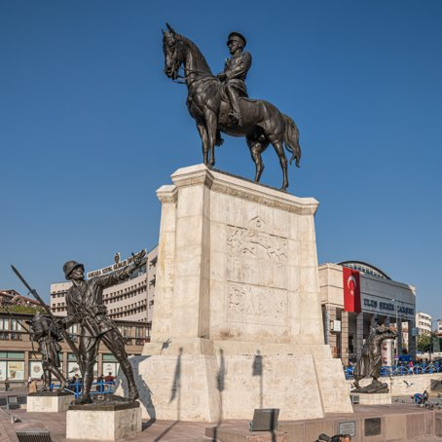
ULUS VICTORY MONUMENT IN ANKARA, TURKEY

Slide 20
EXPRESS
This monument in Ankara, Turkey was built after the Turkish War for Independence, which was fought from 1919 to 1923, as a result of other world powers occupying and partitioning parts of the Ottoman Empire after they were on the losing side of WWI.​
What emotions are expressed in this statue? ​
How does this statue reflect an attitude of victory?​
Why might this statue have been so important that it was placed in a dominant, central square of a large city?​
What is different or similar about this statue from those of other nations that were part of the Central Powers?

Slide 21
EXPRESS
SLIDE 3: Kranz, Rolf, “Thiepval Memorial to the Missing of the Somme,” wikicommons, 16 May 2017, https://commons.wikimedia.org/wiki/File:Thiepval,_Memorial_to_the_Missing_of_the_Somme.jpg. ​
SLIDE 5: Wikibob, “World War 1 war memorial in Cernobbio,” wikicommons, 30 August 2005, https://commons.wikimedia.org/wiki/Cernobbio#/media/File:World_War_1_war_memorial_in_Cernobbio_left.jpg. ​
SLIDE 7: Steves, Rick, “Verdun France” Rick Steves, accessed 13 June 2018, https://www.ricksteves.com/watch-read-listen/read/articles/verdun-a-lesson-about-war. ​
SLIDE 9: Guderian, Greg, “World War Memorial- Englewood,” United States WW1 Centenial Commision, accessed 13 June 2018, https://www.worldwar1centennial.org/index.php/nj-wwi-related-locations/780:world-war-memorial-englewood.html. ​
SLIDE 11: Burrows, “Hungarian World War 1 Memorial,” wikicommons, 25 May 2008, https://commons.wikimedia.org/wiki/File:First_World_War_Memorial_Mak%C3%B3.JPG. ​
SLIDE 13: Lockstone, Brian and the New Zealand Archives, “New Zealand Memorial,” New Zealand Foreign Affairs & Trade, 2012, https://www.mfat.govt.nz/en/countries-and-regions/europe/france/new-zealand-embassy/anzac-day-commemorations/longueval/. ​
SLIDE 15: From the National WWI Museum and Memorial Collection, https://theworldwar.org/research/database ​
SLIDE 17: “Soldiers Journey 2”, National Park Service, accessed 28 September 2023, https://www.nps.gov/media/photo/gallery-item.htm?pg=6694142&id=a1fac44f-5e9c-4971-b2b6-de757ebcf98d&gid=409008E1-B11A-4EB5-8E19-A7FEFE3E6533 ​
SLIDE 19: Savin, A., "Atatürk's equestrian statue known as Ulus Victory Monument in Ankara, Turkey," WikiCommons, 29 September 2023, https://commons.wikimedia.org/wiki/File:Ankara_asv2021-10_img38_Victory_Monument.jpg

