Slide 1
A Day in the Life of a Child
Childhood & Adolescence During WWI

Slide 2
Objectives:
Students will analyze primary sources, such as letters, diaries, and photographs, to gain insights into the experiences of children during World War I
Students will compare and contrast the daily lives of children during World War I with those of contemporary children, identifying similarities and differences.
Students will synthesize information and create a presentation or project that communicates the unique perspectives of children during World War I.
Explore and research using an online museum exhibition.
Use research skills to gather historical knowledge about an artifact.

Slide 3
Guiding Questions
What is your favorite childhood memory?
How would you describe the typical American childhood? The typical day for a child? A teenager?
How different was childhood during WWI? What made it different? (the war? technology changes? societal changes?)

Slide 4
Postcard to the Past
Dear ______________,
What three questions would you ask a child who lived in your town during the first World War?
Student Name
McNair Middle School
Fayetteville, AR 72703

Slide 5
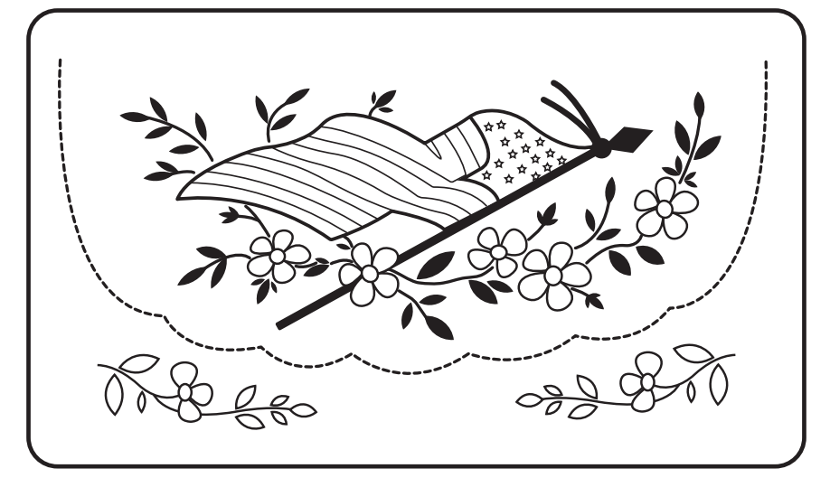
Notes:
Templates of WWI postcards: https://theworldwar.org/sites/default/files/2023-11/2023-wwi-good-luck-coloring-postcards.pdf

Slide 6
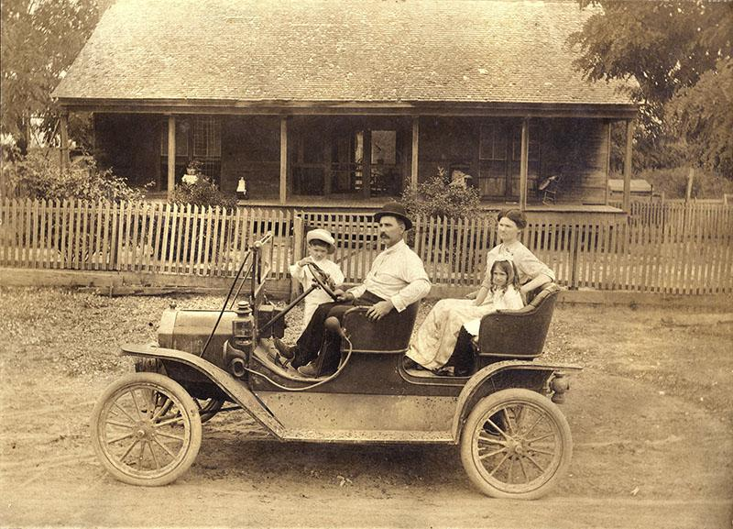
Before the war . . . .
Most American families consisted of a father, mother, and children.
Father worked outside the home
Mother stayed home, kept house, cared for children
Children stayed home with their mother until they started school
Unidentified family in a Ford Model T Tourabout, circa 1910
Notes:
https://flickr.com/photos/crackdog/2602869787

Slide 7
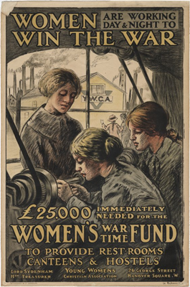
Fathers leave to go to war . . . . .
Many mothers need to work outside the home.
How will this change things for children?
Notes:
Object ID
1920.1.569

Slide 8
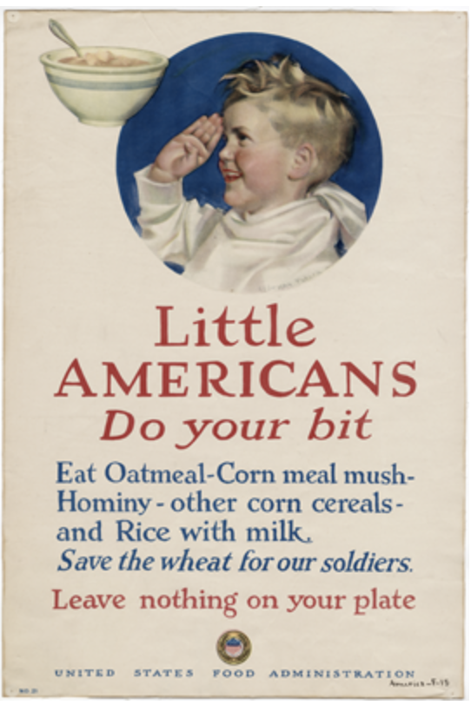
Start Your Day Off Right - Breakfast
All citizens were encouraged to conserve foods like meat and wheat, choosing canned fruits, oatmeal, and foods that did not require butter, milk, or eggs.
Fannie Farmer’s Boston Cooking School Cookbook has this sample menu for breakfast:
fried hominy
maple syrup
raised biscuits
sliced peaches
coffee
Notes:
Object ID: 1920.1.125
American Breakfast Through the Decades
Honestly so much bacon
By Caroline Goldstein
Updated February 13, 2018

Slide 9
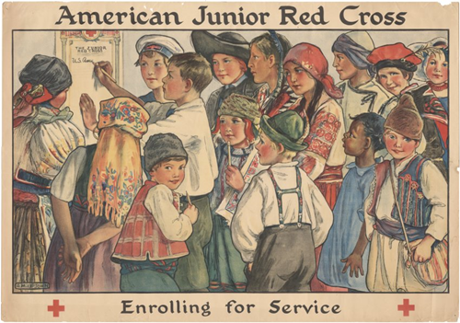
Getting Dressed for the Day
Knickers and knee socks were common for boys.
Knee-length dresses with knee socks for girls
Hair ribbons became the fashion

Slide 10
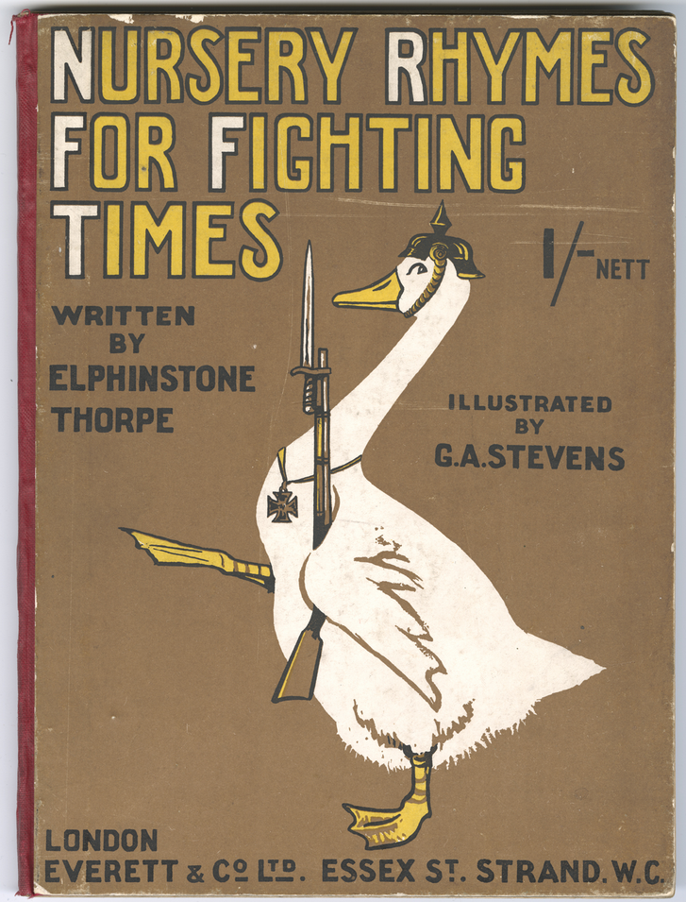
The School Day
What subjects did students learn during their school day?
traditional reading, writing, & arithmetic
gardening
volunteer work
Young students had reading material that reflected sentiments from the war.
Notes:
object id 2023.226.1

Slide 11
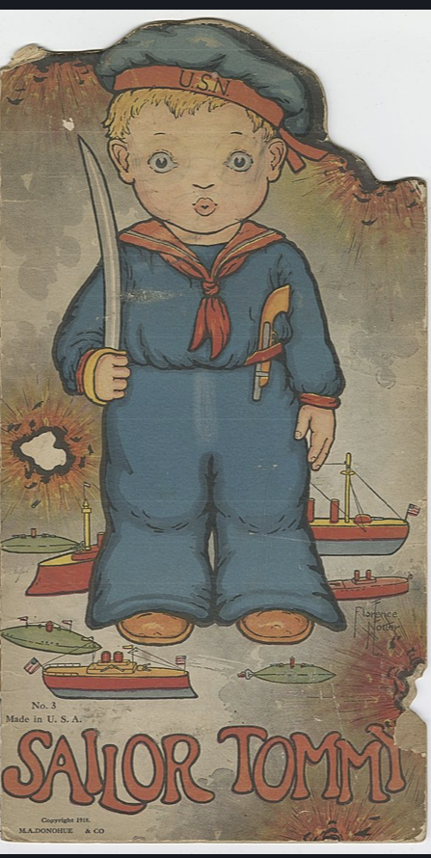
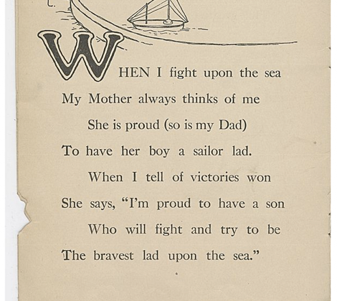
Notes:
object id 2023.123.1

Slide 12
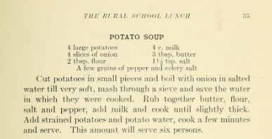
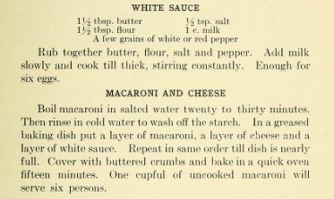
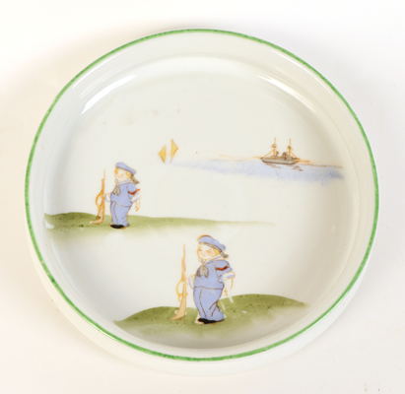
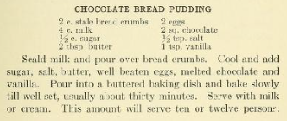
Lunch
Many children brought their own lunch to school, but some schools did serve lunch. These are some recipes from one school that cooked a meal each day.
Notes:
https://archive.org/details/ruralschoollunch00farn/page/40/mode/2up
object id 2023.140.1

Slide 13
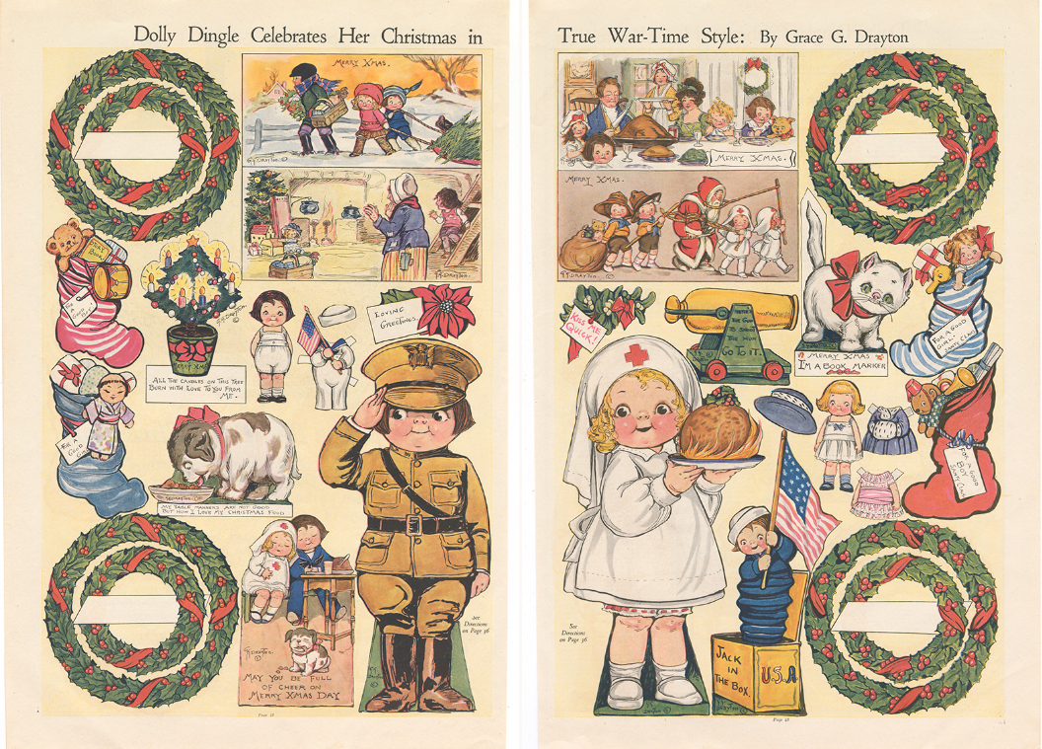
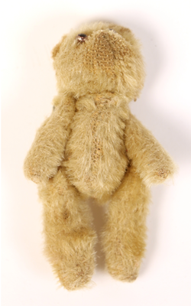
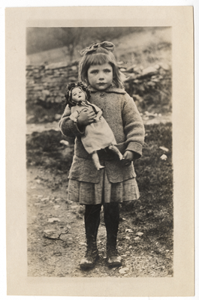
After School Activities
Examples of toys
Notes:
object id 2023.225.1 (bear), 1989.21.18.37 (girl with doll), 2023.124.1 (paper dolls)

Slide 14
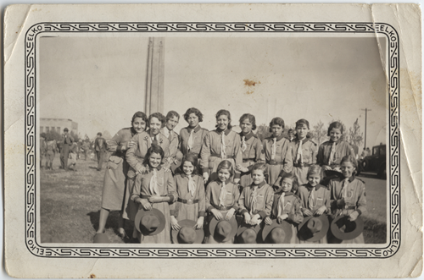
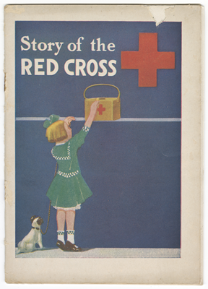
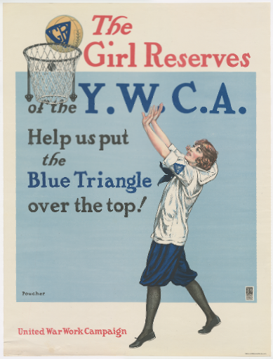
Organizations & Groups
Boys and girls all over the country joined groups such as Boy Scouts & Girl Scouts, the Red Cross, and the Y.W.C.A. They did volunteer work involving making items for soldiers, finding resources the military needed, and conserving food and other rationed goods.

Slide 15
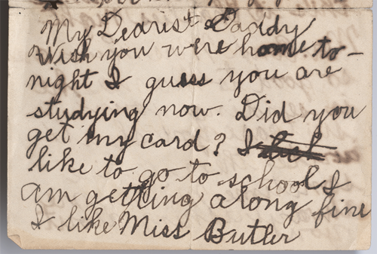
Communication
My Dearest Daddy Wish you were home to-night I guess you are studying now. Did you get my card? I like to go to school I am getting along fine I like Miss Butler. Mr. Pryor gave Charlie a nice watermellon to-night it was all he could carry home he is sure good to us boys. We boys take turn about sleeping with Mama this is Charlies night. Mr. and Mrs. Leux are so good to Mama he is sending your suitcase you should write them a line sometime Millers are always asking about you send best regards to you. We have a fine car in our garage sure a beauty. I must go to bed now a good night kiss and a big hug your little boy Albert Cook X

Slide 16
Building Your Time Capsule
Choose 8-10 items that can serve as an artifact in a time capsule reflective of a child’s life during World War I. Each artifact that you choose should have its own page in a set of slides and should include an image of the artifact and a well-written explanation of what the artifact shows about the daily life and routine of a typical child during the war. Be sure to document the object id for each item and/or where you found this item and information about it.

Slide 17
Time Capsule Rubric
 | 4 - Exemplary | 3 - Proficient | 2 - Developing | 1 - Under-developed
Artifacts | Time capsule includes more than the required 8-10 artifacts. Contents reflect an accurate picture of a child’s life during WWI. | Time capsule includes the required 8-10 artifacts.. Contents reflect an accurate picture of a child’s life during WWI. | Time capsule includes fewer than 8 artifacts. Contents somewhat reflect an accurate picture of a child’s life during WWI. | Time capsule lacks in artifacts and therefore doesn’t demonstrate an accurate picture of a child’s life during WWI.
Explanation of Artifacts | There is a detailed, accurate, and thorough explanation for every item in the time capsule. | There is a detailed, accurate, and thorough explanation for most items in the time capsule. | There is a somewhat detailed and mostly accurate explanation for items in the time capsule. | Time capsule lacks explanations for the artifacts included OR explanations are not accurate.
Effort in Written Explanations | Effort clearly demonstrated. Excellent grammar and correct spelling. | Effort met requirements. Grammar and spelling have few mistakes, but they do not distract the reader. | Effort lacking. Numerous spelling and grammar errors. | Writing is not clear or not done and has many grammar and spelling errors.

Slide 18
Exit Ticket
Write a response postcard that answers the questions you posed at the beginning of the lesson. Respond from the point of view of a child who can tell you what you wanted to know about the ins and outs of life as a youngster during WWI.
Notes:
Templates of WWI postcards: https://theworldwar.org/sites/default/files/2023-11/2023-wwi-good-luck-coloring-postcards.pdf

