Slide 1
Marsden Hartley and the great war: learning history through art
Companion presentation to marsden Hartley and the great war lesson
Created by Annie lewis-jones for the national wwi museum and memorial

Slide 2
What do you see in this famous painting? What are the things you notice?
Hartley, Marsden. Himmel, ca. 1914-1915, oil on canvas with artist-painted wood frame. Nelson-Atkins Museum of Art, Kansas City: MO.

Slide 3
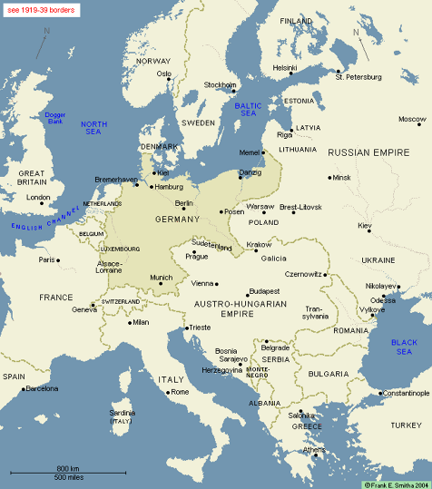
HOW MANY OF THE FIVE GREAT POWERS OF EUROPE IN 1914 CAN YOU NAME?
Great Britain
France
Russia
Germany
Austria-Hungary
Europe, 1914. Copyright Frank E. Smitha, 2004.

Slide 4
empires
The five great powers at the turn of the 20th century controlled much of the world.
At this time, Europe was the major center of economic and political power. The United States was not yet a leader.
The powerful families within these empires had ruled for centuries.
All countries had kept loyalty to a single monarch through the ages.

Slide 5
Areas of dissent
Treaties & alliances
Industrialism & technology
Nationalism
Colonialism
Social unrest

Slide 6
Assassination of archduke franz ferdinand

Slide 7
Dissecting art
After learning about the underlying causes of World War I, are there images in this painting that pop out to you?
Are there any images that could symbolize something from World War I or another historical event?
Hartley, Marsden. Himmel, ca. 1914-1915, oil on canvas with artist-painted wood frame. Nelson-Atkins Museum of Art, Kansas City: MO.

Slide 8
Dissecting art
What famous leader does the statue depict?
Why do you think Hartley’s painting represents celebratory and patriotic emotions rather than showing worry or distress?
Hartley, Marsden. Himmel, ca. 1914-1915, oil on canvas with artist-painted wood frame. Nelson-Atkins Museum of Art, Kansas City: MO.

Slide 9
Analyzing a painting
Consider these questions with historical paintings:
What event is being shown?
What characters are involved, and what are their roles?
What message does the painting contain?
Hartley, Marsden. Himmel, ca. 1914-1915, oil on canvas with artist-painted wood frame. Nelson-Atkins Museum of Art, Kansas City: MO.

Slide 10
Create your own
Create a piece of artwork symbolizing a cAuse of WWI.
CONSIDER your choices carefully and base them on today’s lesson.
Remember, this is not an image of what you think the war would have looked like. This is a symbolic representation of FEELINGS CONCERNING THE ORIGINS OF THE WAR.

