Slide 1
TREATY of versailles
COMPANION PRESENTATION TO THE END OF THE WAR LESSON
CREATED BY CAROL HUNEYCUTT, NATIONAL WWI MUSEUM AND MEMORIAL TEACHER FELLOW

Slide 2
LESSON OBJECTIVES
To understand the attitudes of the France, Great Britain and the United States towards Germany at the end of WWI
To explain the terms of the Treaty of Versailles
To evaluate whether or not the Treaty of Versailles was fair

Slide 3
KEY WORDS
Armistice = an end to fighting
Treaty = a formal written agreement between two or more states
Reparation = pay for damage caused
Re-conquer = get back
Vengeance = revenge

Slide 4
Video clip
This Day in History, November 11, 1918: World War I Ends, ABMC Videos https://youtu.be/_UTUr_Htnaw

Slide 5
Paris peace conference
When the Armistice was signed on November 11, 1918, it was agreed that there would be a Peace Conference held in Paris to discuss what would happen to the defeated powers.
Opened on January 12, 1919, meetings were held at various locations in and around Paris until January 20, 1919.
The Treaty of Versailles dealt with Germany.
Leaders of 32 states representing about 75% of the world’s population attended. However, negotiations were dominated by “the Big 3.”

Slide 6
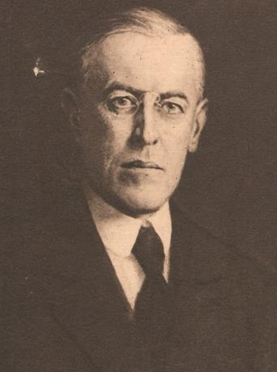
Major players – “The Big 3”
Georges Clemenceau,
France
David Lloyd George,
Great Britain
Woodrow Wilson, United States

Slide 7
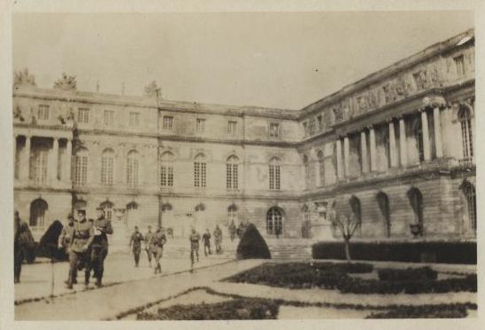
January 1919, Versailles palace
Your table should include four students. Each student will have one of the following roles:
Representing Great Britain… Prime Minister, David Lloyd George
Representing France… President, Georges Clemenceau
Representing the United States of America… President, Woodrow Wilson
Representing Germany… a German representative

Slide 8
Negotiating the treaty
You will be given a headband as a representative of one of the countries at the Paris Peace Conference. Move and sit with others with your same role.
Your first task is to research your role at the conference using the documents provided and internet access.
Discuss with the other representatives from your country what you want from the treaty.
You will only have a few minutes and you need to come up with 3-5 bullet points of what you want!

Slide 9
Negotiating the treaty
Return to your places and your original group.
Now that you have decided on what your country wants, you need to negotiate in order to get it.
There are 6 key areas in which you will need to decide what happens.
Remember you will have to compromise on some things to get other things that you want.
All of the 3 negotiators need to agree on the Treaty before they sign it.
The German representatives – can observe, and must sign, but cannot participate.

Slide 10
How did you do?
We are going to compare your treaty with the real Treaty of Versailles.

Slide 11
Video clips
Part 1
Part 2
The Treaty of Versailles - What did the Big Three Want?, Simple History
https://youtu.be/vrYhLNQMRro and https://youtu.be/0jycVFL8CNM

Slide 12
The treaty of versailles
Harsh – Germany was forced to accept full blame for the war
See the “War Guilt Clause,” Article 231
Independence from Austria – Germany is banned from forming a union with Austria
Take away military – Germany’s army reduced to 100,000 men, no submarines, no airplanes, 36 ships (6 battleships)
Land – Germany lost Alsace-Lorraine to France; kept the Rhineland but had to stay demilitarized
Established the League of Nations
Reparations - $33 billion

Slide 13
Illustrated treaty
Create 6 equally sized squares on your paper.
Design an illustration for each portion of the Treaty of Versailles that shows your understanding of each treaty component (Harsh treatment, Independence from Austria, Military reduction, Land, League of Nations, Reparations)

Slide 14
evaluation
Do you think the Treaty of Versailles was fair?
Explain why you think this.
Were there portions of the treaty that were more fair (or less fair) than others?

