Slide 1
Economics of war: a study of patriotism and finance
Companion presentation to Economics of war lesson
Created By Megan berry, national wwi museum and memorial teacher fellow

Slide 2
Objectives
1. Explore financial savings concepts, including bonds
2. Investigate the impact of war bonds on the economy
3. Illustrate examples of patriotism in WWI and Iraq/Afghanistan
4. Connect WWI financing to current day economic choices in Iraq/Afghanistan
5. Construct a commercial aiming to sell war bonds in support of today’s conflicts

Slide 3
Essential questions
*How do you pay for your obligations or things you want?*
  What do you value about this country?
  How does a government pay for a war?
  What methods were used by the American government to encourage
  Americans to support the war effort?
  How could Americans not involved in combat show their support for the
  war effort?
  In what ways does buying war bonds show patriotism?
  What effect does war have on a government’s economy?

Slide 4
Economic situation
1916: U.S. virtually debt-free
Debt occupied 2.7% of the economy
Shift in production from civilian to military goods
European purchases of war goods created an economic boom
Increase in labor force matched by a decline in unemployment
      1914: 7.1%
      1916: 5.1%
      1918: 1.4%

Slide 5
Dollars and sense
3 Ways to Finance:
  1. Taxes - frighten the wealthy / reduce support
  2. Borrowing - hid the real cost / made war too easy
  3. Printing Money - causes inflation
Economist Adam Smith argued taxes were best - they conveyed the real cost of wars to the public.
Where’s the balance?

Slide 6
How do you pay for a war?
Secretary of the Treasury William Gibbs McAdoo hoped for 50/50 balance
In actuality:
~ 25% of WWI was financed through taxes
~ 50% borrowing from the public
~ 25% money creation
How do you convince people to make sacrifices?

Slide 7
It’s lend or lose
Government plays off of patriotism and conscience
Rebranding of savings bonds
Financial incentives

Slide 8
patriotism
People bought bonds because of feelings of patriotism, nationalism and anti-Germanism
The nation’s best artists and actors were recruited to campaign and sell liberty loan bonds
Each state had a quota of bonds to sell and put pressure on the public to buy
Strong social pressures caused people to buy, including pressure from employers:
  Workers were strongly encouraged to buy bonds by their employers
Teachers were dismissed if they presented anything other than the allied point of view

Slide 9
For home and country
Liberty Loans
5 issues released (varied from 3-4.5% interest)
Sold in denominations from $50-$10,000
War Savings Certificates
$4.12 (4.5% interest)
25-cent stamps - could be exchanged for a war savings certificate
Purchasing opportunity to support the war effort for those with limited means, as well as young people

Slide 10
effectiveness
On the 2nd day of bond sales in April 1917, sales jumped to an average of $480,508 per minute
2/3 of war funds used between 1917-1918 were obtained through Liberty bond sales
Between 1/4 – 1/3 of the entire population of the United States bought a Liberty or Victory bond

Slide 11
effectiveness
It cost little to encourage Americans to be patriotic and to remind them of their public duty
Lots of methods were used to encourage purchase
Americans were determined to show their support

Slide 12
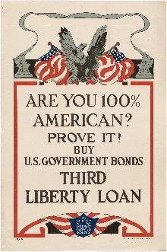
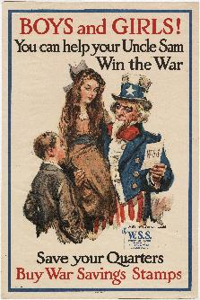
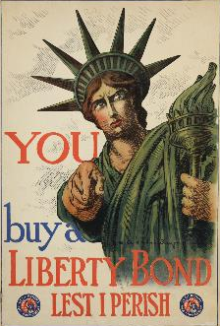
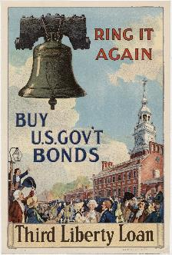
“A war undertaken without sufficient monies has but a wisp of force. Coins are the very sinews of battles.”
-François Rabelais, Gargantua
Posters from the National WWI Museum and Memorial collection.

Slide 13
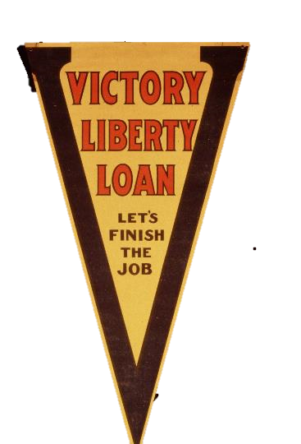
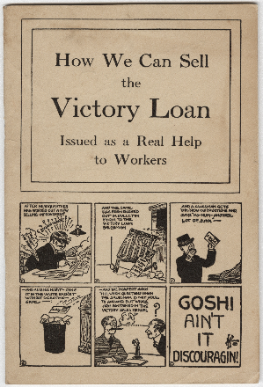
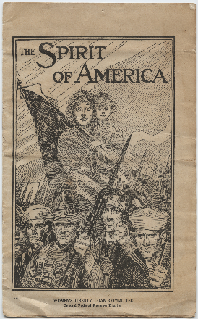
Artifacts from the National WWI Museum and Memorial collection.

Slide 14
Other sales methods –
Committee on Public Information
“Public opinion stands recognized as a vital part of national defense.”
– Woodrow Wilson
The CPI was created in April 1917 and headed by George Creel
Produced posters, pamphlets and patriotic films
Created speaker’s campaign with men and women volunteers who delivered four-minute speeches during movie intermissions at theaters and other public places. They encouraged public support of the war, including the purchase of war bonds

Slide 15
The final outcome
YEAR | BILLIONS OF DOLLARS | % GDP
1917 | 6 | 10.9
1918 | 16 | 23
1919 | 9 | 11.7
1920 | 1 | 1.1
TOTAL | 32 | 46.6
In today’s money, that’s $548 billion

Slide 16
COST OF WAR TODAY
2003 – 2011 $1.06 trillion spent on Iraq War
Since 2001 $1.07 trillion spent on war in Afghanistan
The Afghan and Iraq wars are more than five times more expensive than
World War I
Today it costs $3.9 million dollars to keep one soldier in Afghanistan for a year
Iraq & Afghanistan wars are funded through debt.
Why not Liberty Bonds?

Slide 17
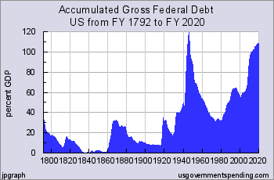

Slide 18
assessments
STUDENTS WILL CHOOSE ONE OF THE FOLLOWING OPTIONS:
Create a comparison of patriotism between WWI and today in a visual essay
2. Create a commercial to sell war bonds for today’s conflicts (iMovie, radio, etc.)
3. Give a “Four-Minute Man” speech to sell war bonds for today’s conflicts
4. Another idea that is not listed above? Just ask!

Slide 19
citations
Amadeo, Kimberley. “Cost of Afghanistan War: Timeline, Economic Impact.” The Balance. Updated January 11, 2018. Web. <https://www.thebalance.com/cost-of-afghanistan-war-timeline-economic-impact-4122493>
Amadeo, Kimberly. “Cost of Iraq War: Timeline, Economic Impact.” The Balance. Updated December 30, 2017. Web. <https://www.thebalance.com/cost-of-iraq-war-timeline-economic-impact-3306301>
Cordesman, Anthony. “U.S. Military Spending: The Cost of Wars” Report. July 10, 2017. Center of Strategic and International Studies. Web. <https://www.csis.org/analysis/us-military-spending-cost-wars>
Daggett, Stephen. "Costs of Major U.S. Wars." Congressional Research Service 7-5700 (2010). Web. <http://cironline.org/sites/default/files/legacy/files/June2010CRScostofuswars.pdf>.
"Four Minute Men - Echoes of the Great War: American Experiences of World War I." The Library of Congress. Web. <https://www.loc.gov/exhibitions/world-war-i-american-experiences/online-exhibition/over-here/surveillance-and-censorship/four-minute-men>
Keckeisen, Sara. "The Cost of Conscience Part 1." Kansas Heritage Summer (2004). Web. <https://www.kshs.org/publicat/heritage/2004summer_keckeisen.pdf>.
Rockoff, Hugh. "UNTIL IT’S OVER, OVER THERE: THE U.S. ECONOMY IN WORLD WAR I." NBER WORKING PAPER SERIES 1 June 2004. Print.

Slide 20
citations
Rockoff, Hugh, and Sung Kang. "Capitalizing Patriotism: The Liberty Loans of World War I." NBER WORKING PAPER SERIES 2006. Print.
Shipman Andrews, Mary. Her Country: A Story of the Liberty Loan. Charles Scribner's Sons, 1918. Print.
St. Clair, Labert. The Story of Liberty Loans. Nabu Public Domain Reprints, 1919. Print.
Story, Louise. "Buying a Share of Victory. Or Not." The New York Times. The New York Times, 2 Jan. 2010. Web. 20 May 2015. <http://www.nytimes.com/2010/01/03/weekinreview/03story.html?_r=0>.
"The Patriot Savings Bond." Treasury Direct. Bureau of the Fiscal Service, 18 Dec. 2013. Web. 20 May 2015. <https://www.treasurydirect.gov/indiv/research/indepth/ebonds/res_e_bonds_eepatriotbond.htm>.
“The Birth of Modern public relations”, museum label. Kansas city, Mo: the national wwi museum and memorial.
"WWI Home Front: Manipulating Minds: The War Propaganda Machine." WWI Home Front: Manipulating Minds: The War Propaganda Machine. 9 Nov. 2012. Web. 20 May 2015.

