Slide 1
Zimmermannland:
The Southwestern Front of World War I
Lesson by Will Reimers,
National WWI Museum and Memorial Teacher Fellow

Slide 2
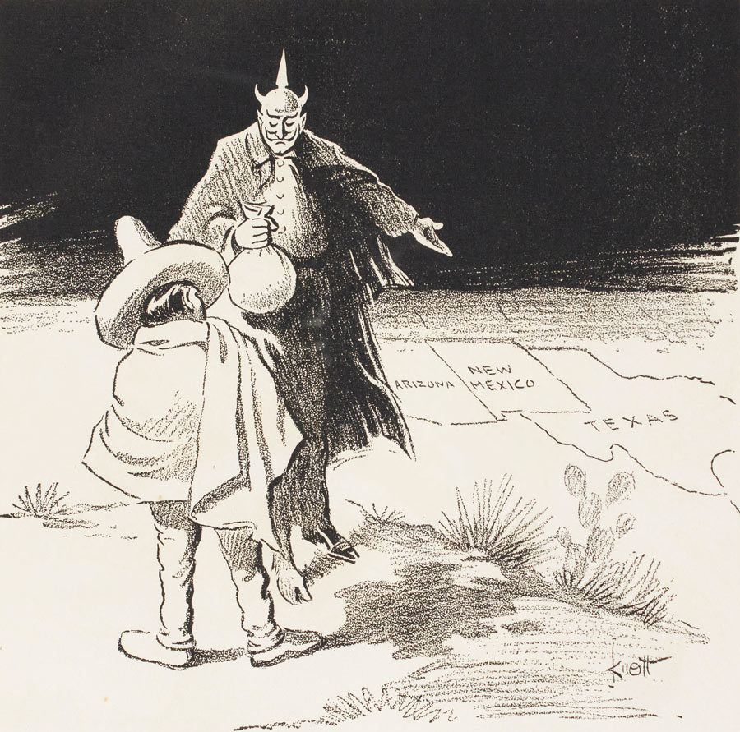
Zimmermannland:
The Southwestern Front of World War I
Knott, John. "The Temptation." Cartoon. In War Cartoons by Knott. Self Published.
"Book, 2010.10.0" (Kansas City, Mo.: National WWI Museum and Memorial).

Slide 3
Objectives
Explore the increasing dissonance in U.S.-Mexico relations 1910-1916
  Geography, Society, Technology, Economics & Politics
Investigate the impacts of the Zimmermann Note on residents of Arizona, New Mexico, and Texas 1917-1919
  G.S.T.E.P.
Explain the continuing influence of this era on U.S.-Mexico
relations today
  G.S.T.E.P.

Slide 4
Standards
National Council for Social Studies C3 Framework Inquiry Arc
  Develop Questions
  Apply Disciplinary Tools
  Evaluate Sources/Evidence
  Communicate Conclusions

Slide 5
Essential Questions
  To what extent was the inherent threat of the Zimmermann Note a reality in 1917-1919? (U.S., Mexico, Germany Point of View)
  How did US-Mexico relations evolve over the course of the Mexican Revolution 1910-1916?
  How did Americans in Zimmermannland react to the Zimmermann Telegram during 1917-1919? (AZ, NM, TX Point of View)
  To what extent do these events influence U.S.-Mexico relations today? (U.S., Mexico Point of View)

Slide 6
EQ1: THREAT ASSESSMENT
To what extent was the inherent threat of the Zimmermann Note a reality in 1917-1919?

Slide 7
Battle of Ambos Nogales
August 1918, on the US-Mexico Border
  AugUST 15, U.S. forces receive anonymous letter that Germans are instructing Pancho Villa’s forces at Nogales, Sonora
    States German military directed attack planned for August 25
  US Army intelligence investigations confirm most facts of letter
    Mexicans digging trenches
    Frequent Mexican patrols
    Increasing hostility at Nogales Sonora to Nogales Arizona by Mexican Guards
  16:10 hours, August 27, 1918
    Mexican national ignores US Customs inspector Arthur G Barber and continues into US
    Barber gives chase with pistol drawn, accompanied by Pvt. Klint, Company H of U.S. 35th Infantry
    Pvt. Klint struck and killed by gunfire from Mexican side of border causing other members of Company H to return fire. (Ft. Huachuca Museum)
Portillo, Ernesto, Jr. "He Was 10, but Battle of Ambos Nogales Is Still Vivid."
Arizona Daily Star, 21 Mar. 2010.

Slide 8
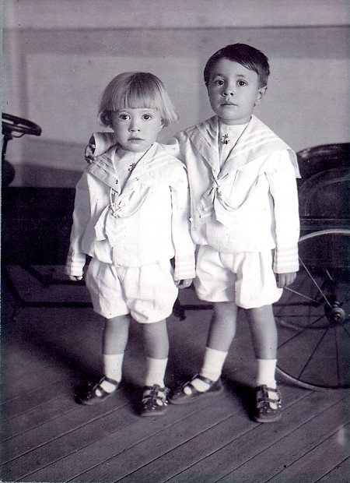
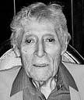
Battle of Ambos Nogales, Continued
  16:10 hours, August 27, 1918
    Mexican national ignores US Customs inspector Arthur G Barber and continues into U.S.
    Barber gives chase with pistol drawn, accompanied by Pvt. Klint, Company H of U.S. 35th Infantry
    Pvt. Klint struck and killed by gunfire from Mexican side of border causing other members of Company H to return fire.
    (Ft. Huachuca Museum)
“My mother took the mattresses and had us hide under them. … We could hear the bullets ricocheting off the alley.”
- Ernesto Celaya Serna (L) with brother Francisco of Nogales, AZ
Portillo, Ernesto, Jr. "He Was 10, but Battle of Ambos Nogales Is Still Vivid."
Arizona Daily Star, 21 Mar. 2010.

Slide 9
EQ2: CONTEXT
How did U.S.-Mexico relations evolve over the course of the Mexican Revolution 1910-1916?

Slide 10
Explore EQ2
Using the EQ2 documents, Create a Post-it Note Timeline of the U.S.-Mexico Relationship 1910-1916
  Document 1-2
  Document 3-4
  Document 5-6
  Document 7-8
Analyze each document for clues regarding the influences of
  Geography
  Society
  Technology
  Economics
  Politics
Cite your sources.
Prepare to discuss your findings with partners and the class.

Slide 11
EQ3: IMPACT
How did Americans in Zimmermannland (Arizona, New Mexico, and Texas) react to the Zimmermann Telegram during 1917-1919?

Slide 12
Investigate
Using the EQ3 documents, draw a cartoon illustrating the impact of the Zimmermann Note on Arizona, New Mexico, and Texas 1917-1919.
  Document 9-10
  Document 11-12
  Document 13-14
  Document 15-16
Analyze each document for clues regarding the influences of
  Geography
  Society
  Technology
  Economics
  Politics
Cite your sources as subtext inside the cartoon.
Prepare to discuss your illustration with partners and the class

Slide 13
EQ4: CONNECT
To what extent do these events influence
U.S.-Mexico relations today?

Slide 14
Connect
Using your prior knowledge, draw a Bubble Thinking Map connecting historical issues in Zimmermannland to issues on the U.S.-Mexico border today.
Analyze your document for clues regarding the influences of
  Geography
  Society
  Technology
  Economics
  Politics
Cite your sources, if known.
Compare your findings using a virtual field trip.
  BBC Mundo Clip http://www.bbc.com/news/world-africa-29937465

Slide 15
Wrap Up
Return to EQ1- To what extent was the inherent threat of the Zimmermann Note a reality in 1917-1919?
Explain your analysis.
Record your answer and submit for today’s class credit.

Slide 16
References
Portillo, Ernesto, Jr. "He Was 10, but Battle of Ambos Nogales Is Still Vivid. "Arizona Daily Star. Arizona Daily Star, 21 Mar. 2010. Web. 17 Mar. 2015. <http://tucson.com/news/local/he-was-but-battle-of-ambos-nogales-is-still-vivid/article_239b2df1-57ff-5fcf-8525-89132ac21f20.html>.

