Slide 1
Thinking like a historian: Artifacts tell trench tales
Lesson by John heeg, national wwi museum and memorial teacher fellow

Slide 2
Objectives
students will be able to detail the challenges of wwi trench Life.
Students will use critical thinking and questioning to analyze artifacts.

Slide 3
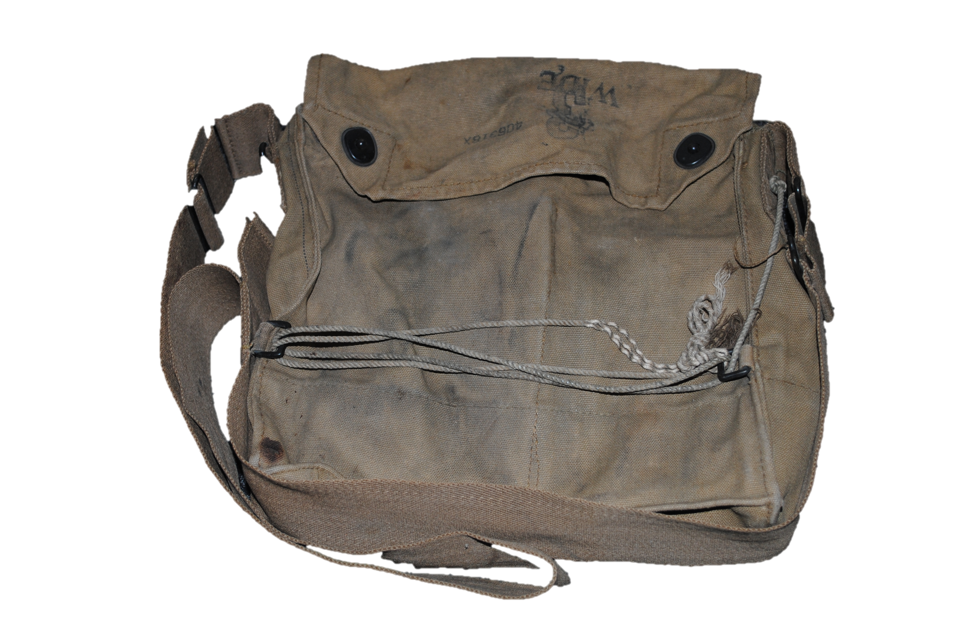
Artifact
An object made by a human being, typically an item of cultural or historical interest.
“Gas mask bag, non-accession collection” (Kansas City, MO: National WWI Museum and Memorial).

Slide 4
Examples of artifacts
Artifacts from the non-accession collection, National WWI Museum and Memorial.

Slide 5
When working with artifacts…
Use archivist gloves
The natural oil on your skin can be very damaging to artifacts.
Only use pencils for notes
The slip of a pen could ruin something that had survived 100 years without damage.
use a magnifying glass to see more detail

Slide 6
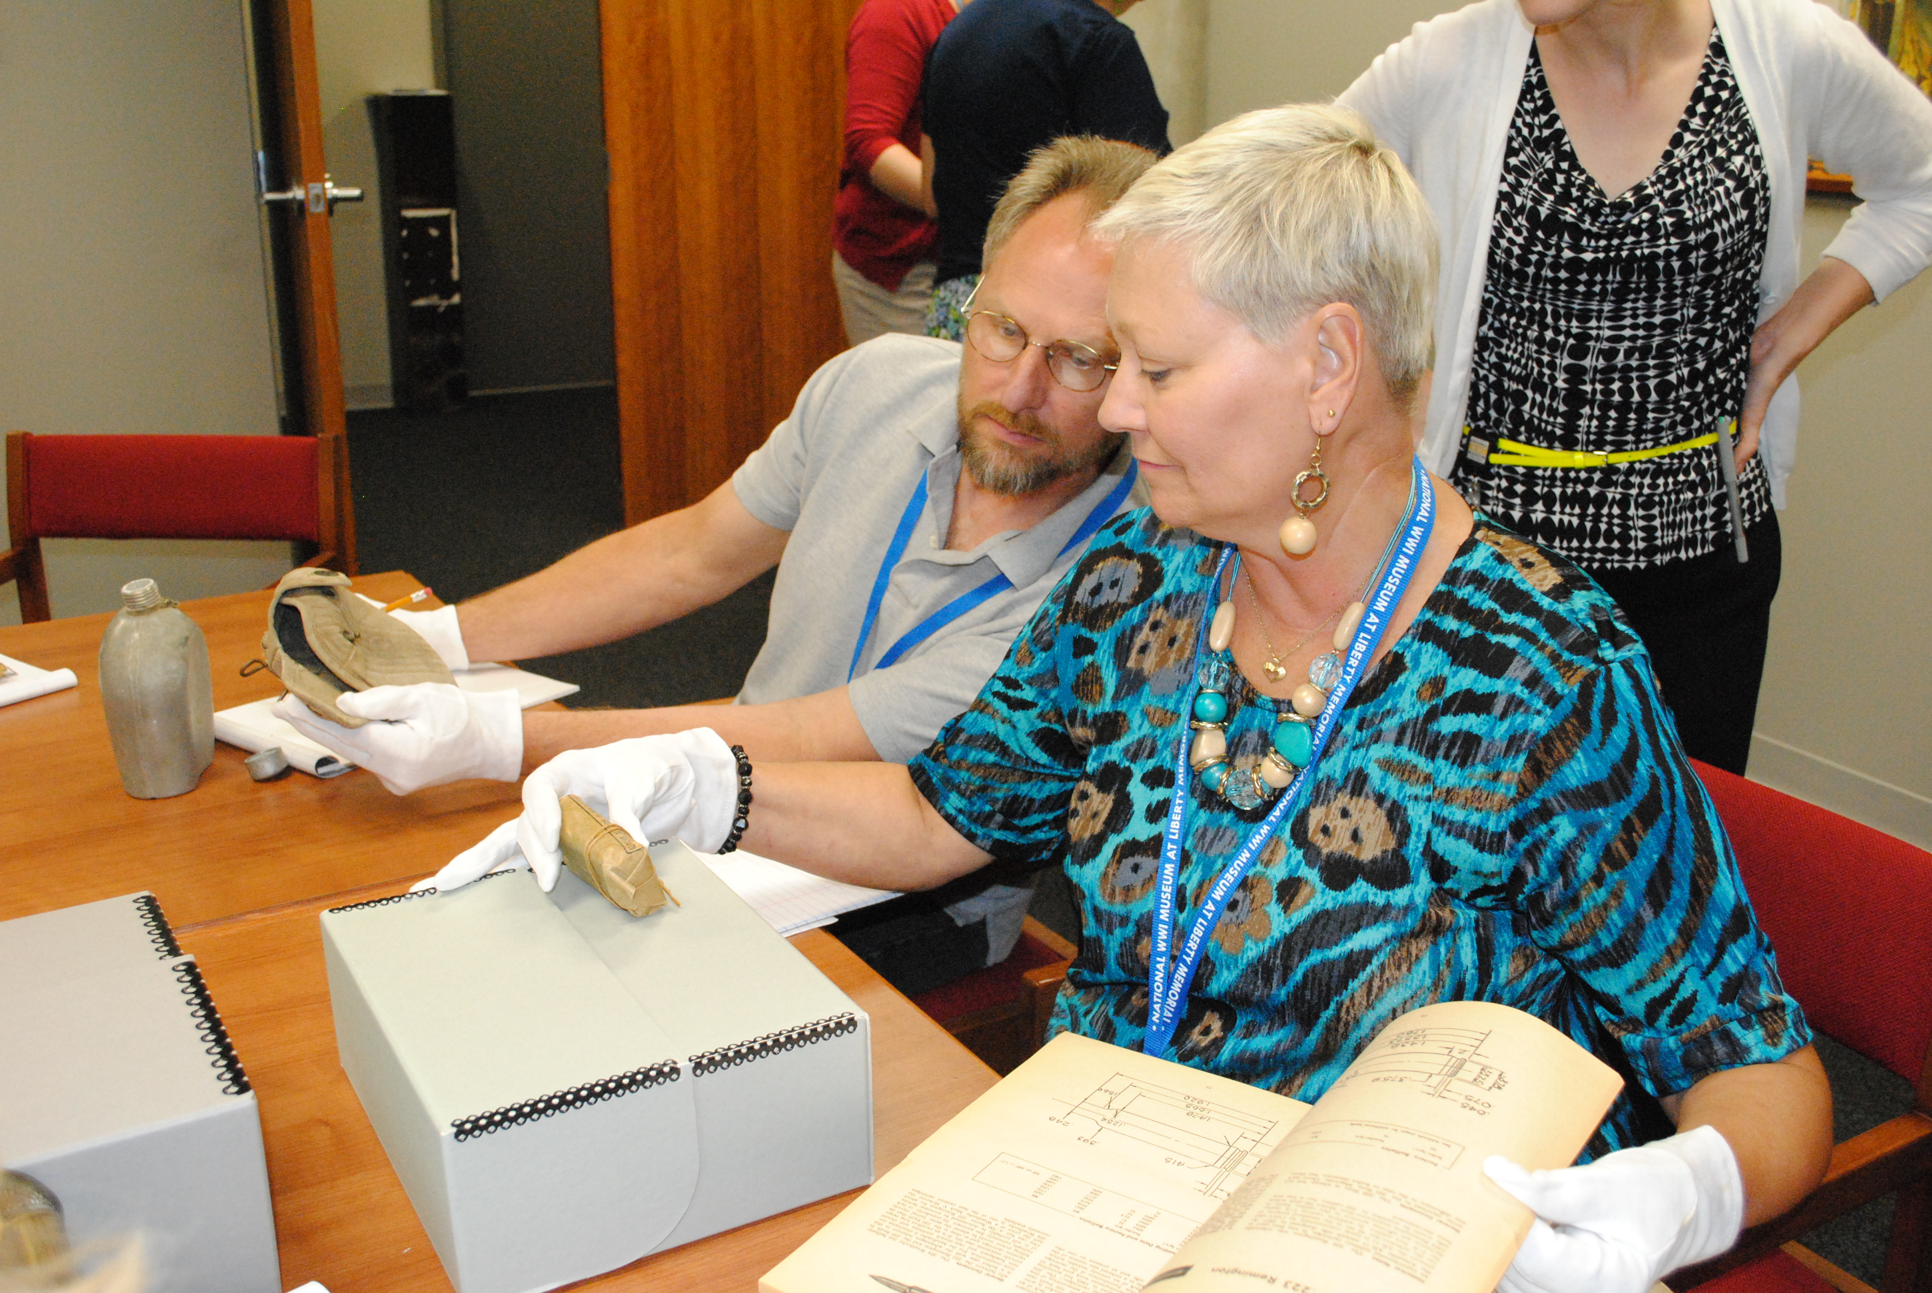
Thinking like a historian
Even experts don’t know all the answers.
This is a process involving
Asking questions
Making observations
Doing research

Slide 7
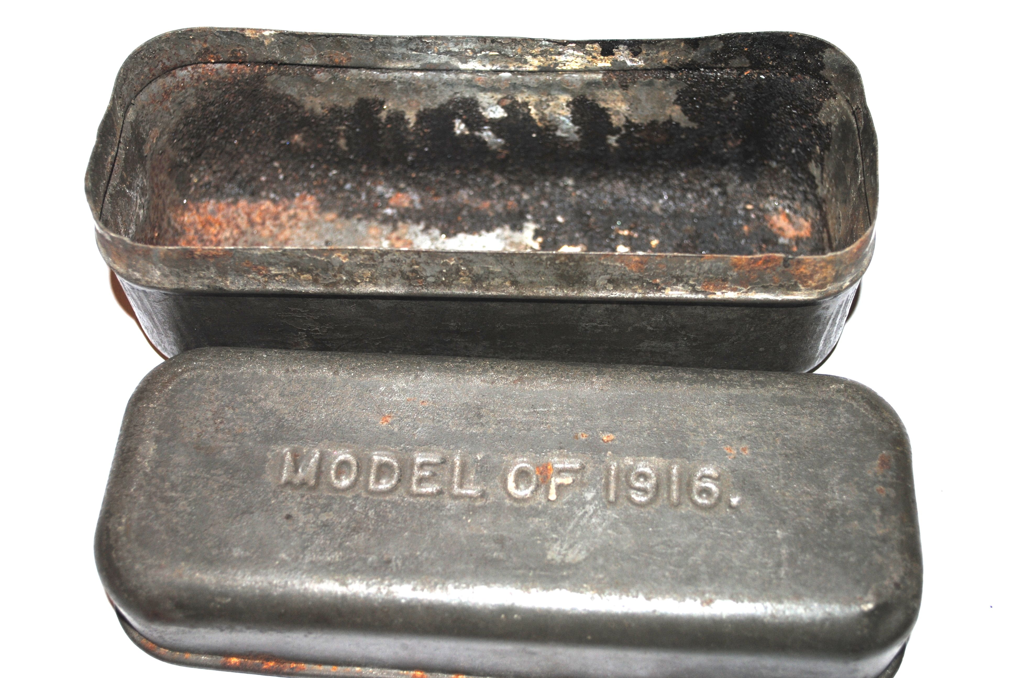
What can you learn from the past by examining an artifact?
“Bacon Box, non-accession collection” (Kansas City, MO: National WWI Museum and Memorial).

Slide 8
Every artifact belonged to someone. They were carried by a soldier in the war. What stories do they it tell?
“Shaving mirror, non-accession collection” (Kansas City, MO: National WWI Museum and Memorial).

Slide 9
Review – what was life like in the trenches?

Slide 10
Digging new trenches
“Digging a trench, Camp Hancock photo, 1983.49.16” (Kansas City, MO; The National WWI Museum and Memorial).

Slide 11
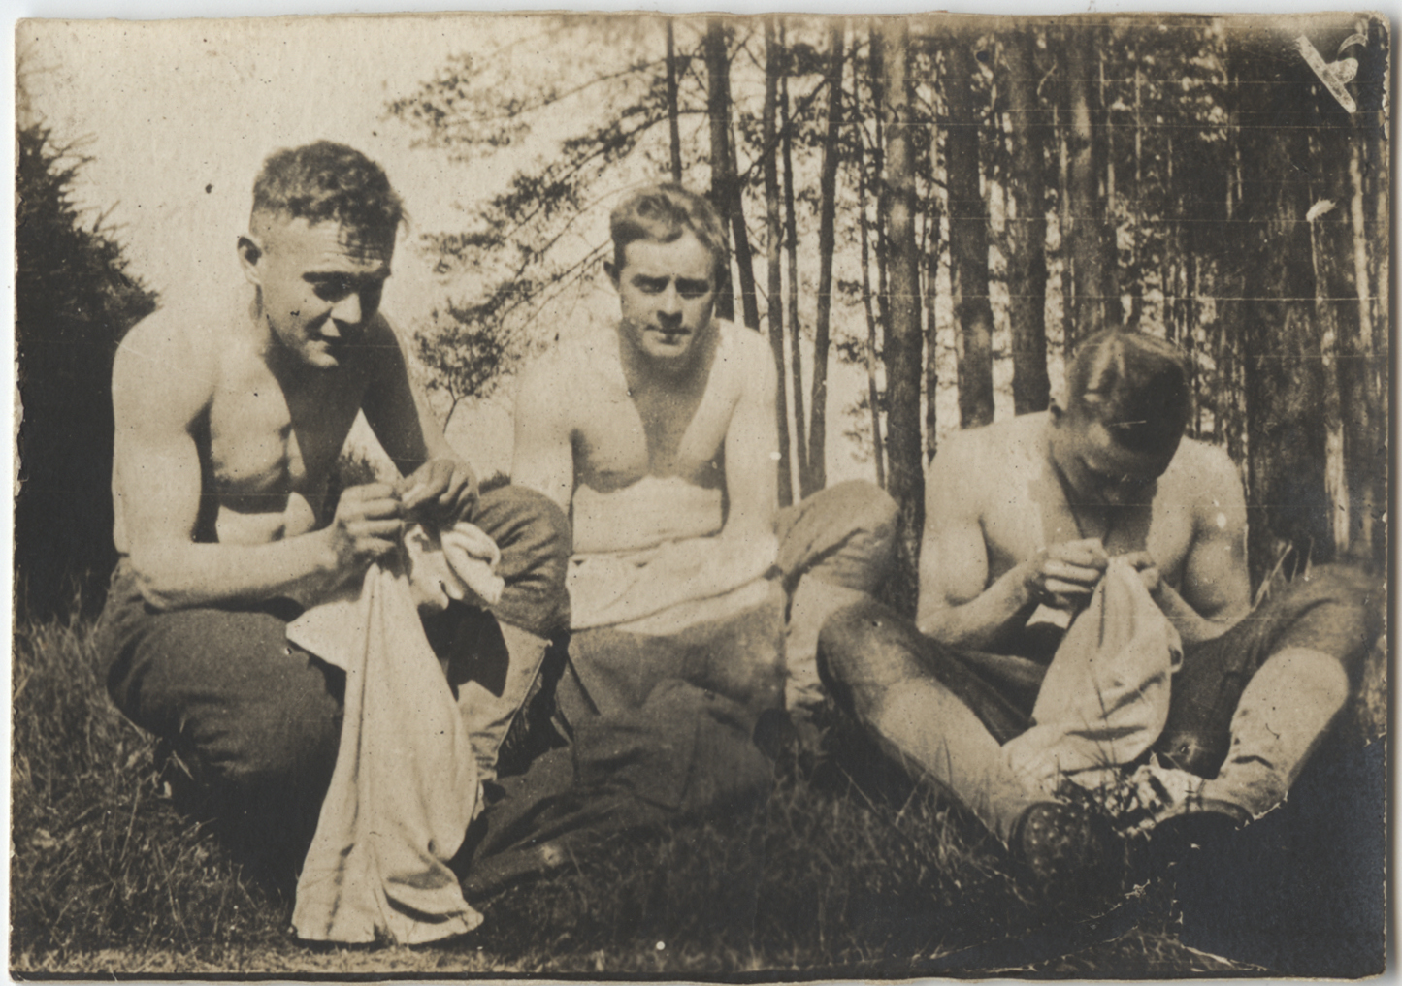
cooties
“Three unidentified soldiers picking lice from shirts photo, 1986.2.43” (Kansas City, MO: National WWI Museum and Memorial).

Slide 12
Dinner in the trenches
“Canadians Wounded at Hill 10 eating, photo, 1997.19.15” (Kansas City, MO: National WWI Museum and Memorial).

Slide 13
DINNER IN A FRENCH TRENCH
“French soldiers in a trench photo 1976.227.30” (Kansas City, MO: National WWI Museum and Memorial).

Slide 14
BATTLE
“German Machine Gunners Retreating (Belleau Wood) photo, 1981.107.146” (Kansas City, MO: National WWI Museum and Memorial).

Slide 15
Gas
“French soldiers in gas masks photo, 1976.227.39” (Kansas City, MO: National WWI Museum and Memorial).

Slide 16
Dugouts, north of verdun
“Dugouts at Vacherauville photo, 2007.45.90” (Kansas City, MO: National WWI Museum and Memorial).

Slide 17
In the winter
“German soldiers in trench photo, 1940.1.5” (Kansas City, MO: National WWI Museum and Memorial).

Slide 18
“Doughboy’s home”
“Doughboy’s Home postcard, 1983.122” (Kansas City, MO: National WWI Museum and Memorial).

Slide 19
Cooperative learning ACTIVITY
Each group of students will receive an artifact and an artifact analysis worksheet. As a group use your knowledge of social studies and World War I to draw a conclusion about your artifact and its purpose.

Slide 20
sharing
What did YOUR GROUP conclude ABOUT YOUR ARTIFACT?
How did you come to that conclusion?

Slide 21
closure
What can an examination and analysis of an artifact tell you about the past?

