Slide 1
Animals of the great war
Carol huneycutt
Teacher fellow, world war I museum and Memorial

Slide 2
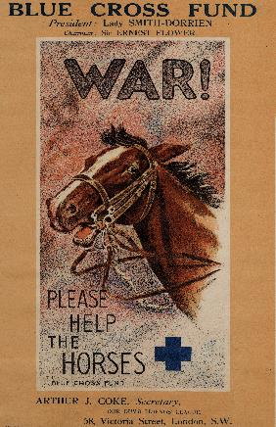
Horses
During the course of the war, approximately one million horses were used by soldiers on both sides of the conflict.

Slide 3
Horses were used to transport goods and troops.
Horses were used as a part of the cavalry.

Slide 5
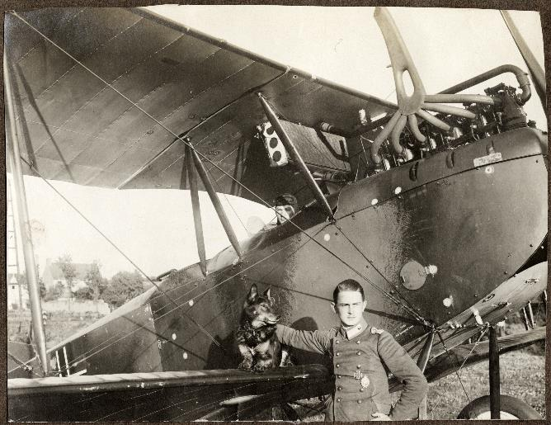
Man’s best friend

Slide 6
Jobs of the Dog
Locate wounded soldiers
Help wounded soldiers
Carry messages
Serve as mascot and friend
Hunt & kill rats in the trenches

Slide 7
Pigeons
Efficient means of communication
Travel up to 60 mph
Travel several hundred miles
Hard to bring down by the enemy
Considered a weapon of war

Slide 8
Small cylinder attached to pigeon’s leg contained a message
Could be released from the front lines or from the rear, from airplanes, or from sea

Slide 9
camels
Camels were of similar use as horses, just not in the same numbers. Camels were used to transport goods and soldiers, mainly in the middle eastern campaigns.
Not easy to manage and frequently had health problems; Only good in desert environment

Slide 10
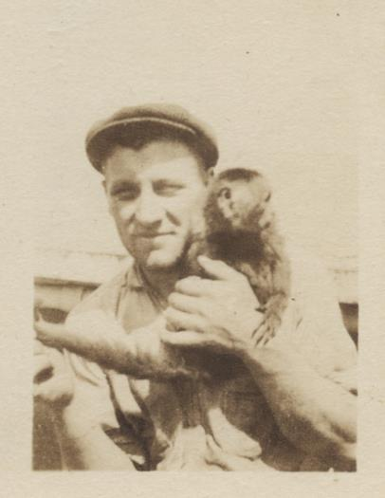
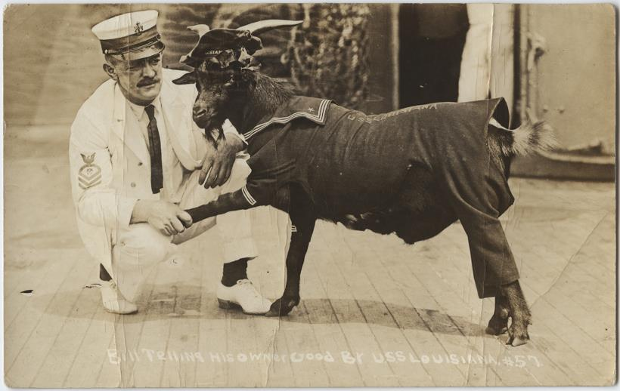
Mascots

Slide 11
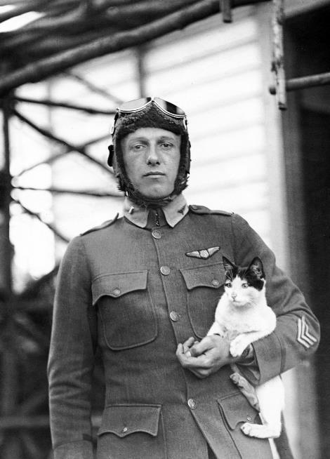
Many different types of animals served as mascots: bears, monkeys, goats, cats, & even a kangaroo.
Mascots were often animals found in the area WHERE soldiers were stationed.
Mascots helped ease loneliness and boredom and reminded soldiers of home.

Slide 12
Even Bears . . . . . .
One of the more famous mascots was a bear, Winnie, from Ontario, Canada. She looked a lot like the bear pictured here. Winnie inspired A.A. Milne to create Winnie the Pooh.

Slide 13
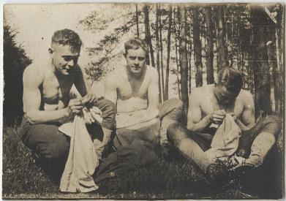
Pests
Rats were abundant in the trenches, spreading lice & disease, stealing food, and biting soldiers.
Body lice made trench life even more miserable. Lice covered soldiers’ bodies & their clothing as well as spread diseases such as typhoid and trench fever.
Other creatures
Jars of glowworms provided light during nighttime hours.
Slugs shrivel up when exposed to poison gas, so they were used as an early warning detector for mustard gas.
Canaries also helped detect gas.

Slide 14
All images are from the National WWI Museum and memorial collection.

